Slide 1
SUICIDE
PREVENTION &
SUPPORT
A JOURNEY TO HOPE

Slide 2
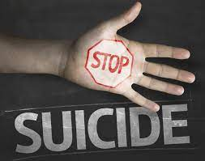
INTRODUCTION
The purpose of this presentation is to shed light on the critical issue of suicide and to raise awareness about suicide prevention. We aim to provide information, resources, and strategies to empower individuals and communities to prevent suicide

Slide 3

What is suicide?
Suicide is the act of intentionally taking one's own life, including mental health issues, emotional distress, social, economic, or environmental factors, and personal experiences.

Slide 4
RISK FACTORS
01
02
03
04
05
06
Mental health issue
Substance Abuse
Previous Attempt
Bullying & Stigma
Financial stress
Society & Family Influence

Slide 5
IMPACTS ON MENTAL HEALTH
Reduced Stigma
Help-seeking Behaviour
Decreases judgment and shame.
Encourages seeking professional help.
Early Intervention
Community Support
Prevents suicides through early recognition.
Fosters a safety net in crisis.

Slide 6
The Role of Education
Promoting Understanding
Effective Communication
Education clarifies the psychological factors behind suicide.
Emphasizes effective dialogue and listening.
Identifying Warning Sings
Teaches recognizing signs in self and others.

Slide 7
SEEKING HELP
Seeking help for suicide awareness is Important for individuals struggling with suicidal thoughts or for those who want to support someone in need.
Support Groups
Therapists and Counselors
Medication
Family & Friends

Slide 8

PROTECTIVE FACTORS
How to stay strong and safe?
Having people who care about you, like friends and family, is a big protective factor.
Feeling good about yourself and having hope for the future can protect you from feeling suicidal.

Slide 9
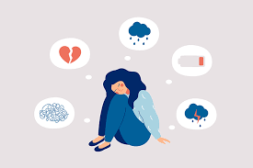
WARNING SINGS
Sing that shows someone needs help
If someone talks about feeling very sad, hopeless, or wanting to die, it's a warning sign.
When someone starts giving away their things or avoids friends, it's a sign they might be struggling.

Slide 10
MYTH vs FACTS
Myth | Vs | Facts
Talking about suicide will make someone do it Nothing can help a person who's suicidal. | Vs Vs | Talking can help them find support. Many people recover with the right help and care.

Slide 11
SUICIDE PREVENTION STRATEGIES
Raise Awareness
Crisis Hotlines
Mental Health
Education
School-Based Programs
Research & data collection
Training for healthcare professionals

Slide 12
Supporting Loved One
Active Listening
Stay calm and Non-judgemental
Show Empathy
Avoid Minimizing Feelings

Slide 13
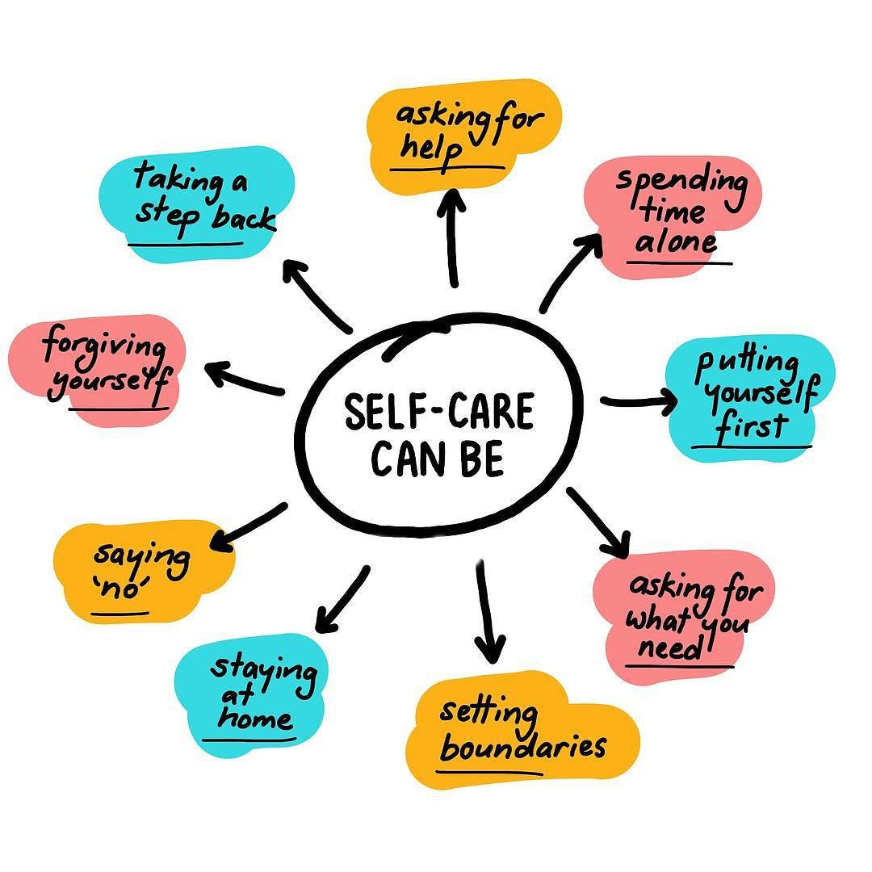
SELF CARE
By caring for your mental health, you create a healthier, more empathetic environment that encourages others to seek help and support.
Prioritizing self-care sets a positive example, reduces stigma, and equips you to offer practical support to those at risk of suicide.

Slide 14
Community Involvement
Educate yourself
Awareness campaign
Community, workshop &training

Slide 15

Postvention
Partners with local educational institutions to implement mental health programs, awareness campaigns, and support services for students and staff.
Connect them with grief counseling, support groups, and relevant resources.

Slide 16
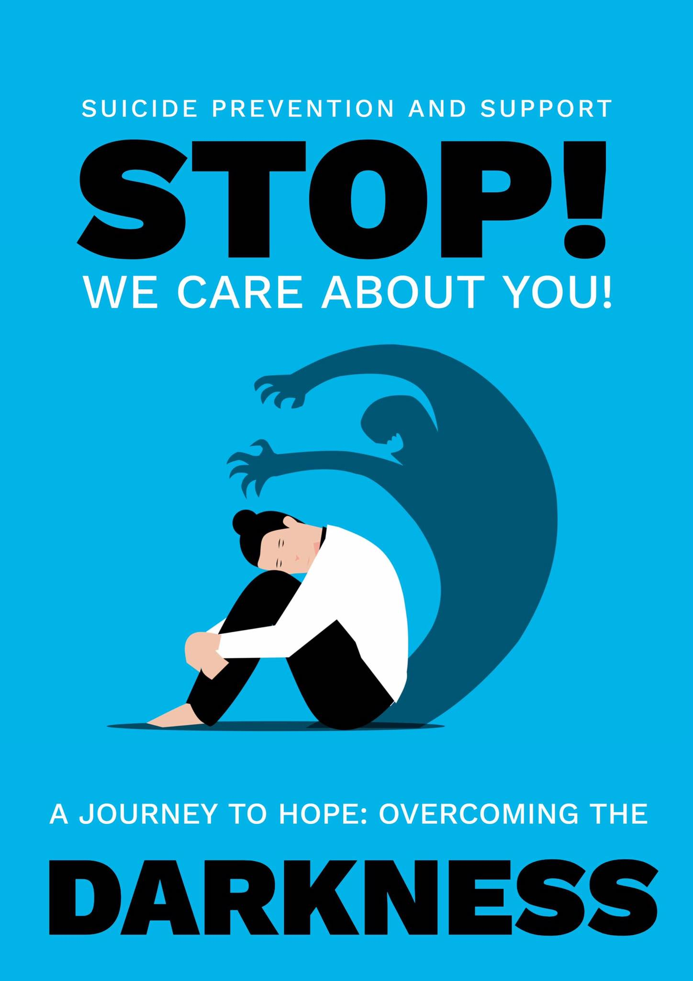
CONCLUSION
Creating awareness and support for mental health and suicide prevention is an ongoing effort that requires the active participation of individuals and the community as a whole. By working together and involving mental health professionals and organizations, we can make a significant impact in our community.

Slide 17
Thanks!
Do you have any questions?

